Slide 1
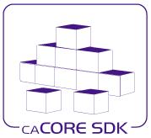
SDK (Software Development
Kit)

Slide 2
caCORE SDK
NCICB’s platform for data management and semantic integration
  Built using formal techniques from the software engineering and computer science communities
A framework for data management and application development
  Creates, compiles, and runs caCORE-like software
  Builds a system for collaborative research environment built on Model Driven Architecture (MDA), n-tier architecture, and consistent API
Framework to generate a Data Service
  Enables users to quickly build the APIs from UML Model
  Syntactically interoperable APIs (Query via information model)
Includes the semantic underpinning for interoperable data and analytical services
Integrated security
Built using open source tools and technologies
Notes:
What is caCORE SDK? It is a framework to generate a data service or application based on the caCORE framework. The SDK is a very simple tool to build applications for a collaborative research environment. The SDK takes a UML model as input and builds Application programming Interfaces (APIs) for that domain. The power of the with SDK is not that it just creates the data service, you can probably find a better data service than SDK provides, but consider that there are 80 different users who have generated the data service with SDK.
In order to get the data from any of the systems, you don’t have to know all the details about that particular system, all you have to know is the information model or the UML model for that particular system. So, if I want to query a caBIO application I will create a new instance of a gene, I will populate the parameters (query by example) where I want to get all the genes that match my query. So from the genomic base application consider you go to a clinical trial space application, you want to search for all the patients who match a certain criteria. You don’t have to know the details of that application; all you have to know is how to create an example for the patient. SDK allows that particular powerful interface and provides it with built-in security with help of a common security module. Since SDK is built using open source tools and technology, you don’t have to worry about any licensing issues or anything- if you want to extend it or modify it, you are welcome to do so.

Slide 3
caCORE SDK
Scope
  Generate a data service from UML model
  Support ArgoUML and Enterprise Architect
  Integrated security
  Integrated logging and auditing
  Use open source tools and technologies
  Support ISO 21090 data types
  Generate Writable API
  Generate client interfaces
  Generate REST-like query support
caCORE SDK Users
Clinical Trials
  C3PR
  CTOM
  Cactus
Genomics
  caArray
  caIntegrator
  caBio
  Rembrandt
Proteomics
  PIR
Imaging
  NCIA
Tissue Banking
  caTissue
Infrastructure
  EVS
  caDSR
  UML Project

Slide 4
Benefit of Using the caCORE SDK
Streamlines the informatics development throughout academic, government, and private research labs and clinics
Generates a system that allows for easy access to data, particularly by other applications
Provides a consistent UML representation of data
Generates data service rapidly
Provides a uniform way to access data
Provides ability to query using information model
Integrated with caGrid
Notes:
Here are a few benefits of using the caCORE SDK:
Streamlines the informatics development throughout academic, government, and private research labs and clinics
Generates a system that allows for easy access to data, particularly by other applications
Provides a Consistent UML representation of data: Users of the caCORE SDK are required to represent their data in UML format. As a user of the SDK, the user is likely to maintain their UML model throughout the life cycle of the application. The same UML model can be used to quickly learn about the organization of the data at various levels in the application.
Rapid data service generation: The SDK can generate caBIG’s silver-level compatible APIs quickly from the UML model. Once the UML model and the database are ready, the data service can be generated in a matter of hours. Manually building the application from the ground up can take several months to achieve the same functionality.
Uniform way to access data: SDK-generated systems provide uniform access to the data stores. Other applications developed using the caCORE SDK have similar mechanisms to retrieve the data. Thus common data representation allows multiple applications to share data.
Query using information model: SDK-generated systems also allows queries to be written in various ways including Query By Example. Since the query is independent of the system’s implementation, changes in the runtime systems do not affect the client application.
Integration with caGrid: SDK-generated systems can be easily integrated with the caGrid using caGrid’s Introduce Toolkit. Developing caGrid-compatible data services without using caCORE SDK can result in error prone and lengthy processes.

Slide 5
Features
Support for Enterprise Architect and ArgoUML
Supported client interfaces
  Client Server Infrastructure
  Web Services
  REST-like
  Graphical User Interface
Security
  Based on ACEGI security framework
  Class level, Instance Level, Attribute Level
  Concurrent User Access in Secured API
  Supports RDBMS, LDAP and caGrid based user accounts
Support for Connecting Multiple Remote Services from the same Java API Client
Notes:
This slide illustrates a few of the key features
The SDK supports ArgoUML along with Enterprise Architect. ArgoUML provides users an open source alternative to commercial software.
The SDK generates various interfaces for the clients to access data from the underlying system.
Client Server Infrastructure: Provides Java API to access data from remote store
Web Services: generates web services for non-java clients to access the data
Graphical User Interface: Allows a richer user experience. This interface allows user to search data using simple web based interface
Security: Based on Acegi security framework ,users can change security without going into the details of the SDK codebase. CSM offers instance and attribute level security. Finally, users can create many instances of the ApplicationService and login with different user accounts at the same time from different threads of the client application.

Slide 6
Features (cont..)
Writable API
  Supports full array of CRUD operations
  Inbuilt validator to validate the data before insert/update
  Support for specifying the primary key generators, cascade settings etc at the UML model level
Integrated logging and auditing with CLM
  Keeps the trail of changes made in the database
  Provides a web based application to view the audit trail
Support different ways to perform O/R mapping
  Implicit inheritance
  Abstract classes
  Marker interfaces
Query By Example

Slide 7
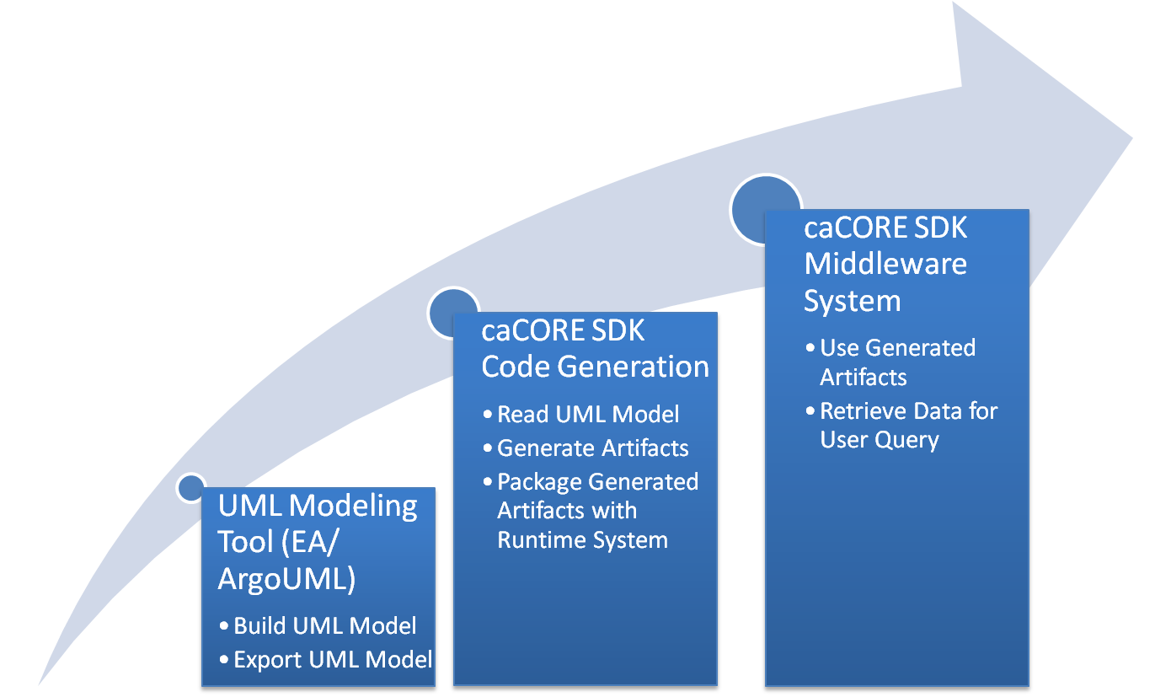
caCORE SDK Workflow

Slide 8
SDK Modules
The caCORE SDK is comprised of 2 Modules:
  Code Generation
    Accepts UML model as input
    Produces various artifacts corresponding to the UML model as output
  Runtime System
    A pre-built system
    Utilizes the artifacts generated by the Code Generation module to serve the data to the client application
Notes:
The caCORE SDK is comprised of two modules. The first module is the Code Generation Module, which accepts a UML model as input and produces various artifacts corresponding to the model as output. The second module is the Runtime System, which is a pre-built system and utilizes the artifacts generated by the code generation module in order to serve the data to the client application.

Slide 9
Features of the Code Generator
Built on Model Driven Architecture (MDA) principle
  System generation from UML class diagrams
  Users are not required to write any code to generate system
Choice for different UML modeling tools
  Enterprise Architect
  ArgoUML
Validation
  Validate logical, data model and mappings
  Validate GME tags
Support for various O/R mapping configurations
  Simple class/attributes
  Associations with and without join tables
  Inheritance mapping (table per class, table per hierarchy, implicit etc.)
Notes:
Here are the primary features of the SDK Code Generator (first module). The SDK takes a UML model as input in order to generate the system, this particular principal is known as Model Driven Architecture (MDA). MDA is a popular concept in which many people are adopting this development approach, not just in caBIG.
Currently, the SDK supports two different UML modeling tools: Enterprise Architect and Argo UML. Enterprise Architect is commercial software (requires a fee to purchase) whereas ArgoUML is an open source (free) UML modeling tool. Another feature of the SDK Code Generator is the support for various O/R (Object Relational) mapping configurations, such as mapping a class to a table. If you want to do use Middle Gen (a tool which will allow you to generate the O/R mapping files right from a UML model of the java classes) -You can do that, but it will not be easy to map complex configurations. Complex configurations might include one-to-many associations with a join table. How do you map that using middle gen? What do you do if you have an inheritance based structure in the object model? You have to know the hibernate syntax. If you use the caCORE SDK,you are not required to know any of these features, SDK will generate the appropriate O/R mapping files for you.

Slide 10
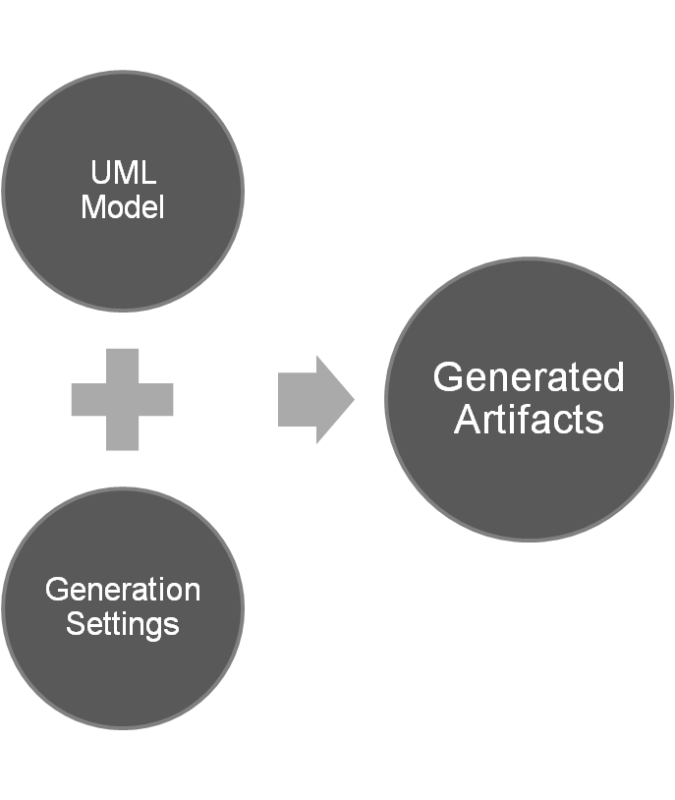
Generated Artifacts from UML
Java beans
Hibernate mapping files
Hibernate Validator
EhCache configuration file
XSD
  Permissible Values
  GME tags
Castor mapping files
JAXB Annotations
WSDD file
Other configuration files
Junit test cases

Slide 11
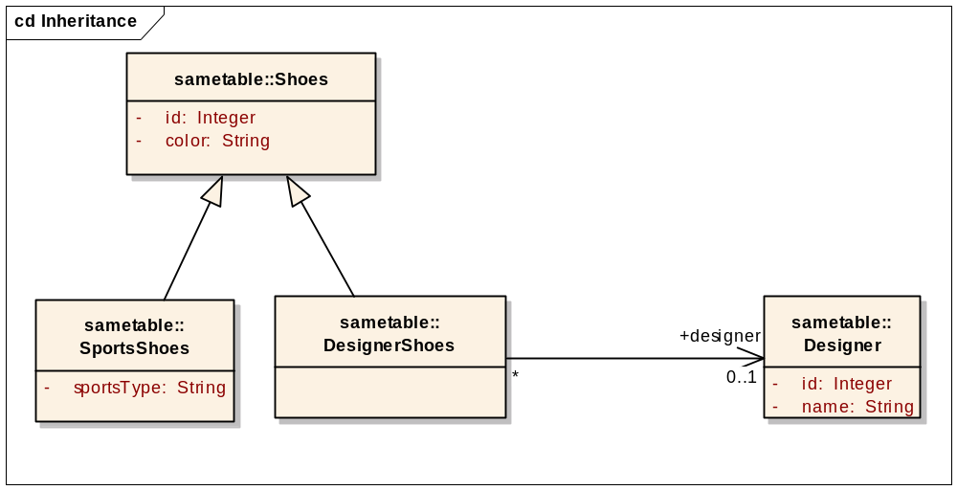
UML Modeling
The SDK reads 1) Logical Model, 2) Data Model, 3) UML Tag values (GME, documentation etc), and 4) Model Mapping information (tag values)
The Logical Model part of the UML model defines the object structure of the domain. Currently SDK supports following UML elements in the logical model
  UML Class
  UML Attribute
  UML Interface
  UML Association
  UML Generalization
  UML Dependency
  UML Tag Value

Slide 12
UML Modeling
Modeling of class attributes including:
  A simple (primitive) attribute, such as an integer or string;
  A collection of simple (primitive) attributes; and,
  An identifier attribute that is named something other than the default (ID) in the Logical (Object) Model.
  A complex ISO 21090 attribute, such as AD (Address)
Modeling of class associations, including:
  Many-to-Many, Many-to-One, One-to-Many, One-to-One, Self, and Multiple associations;
  Uni-directional and bi-directional associations;
  Associations that use and do not use a Join Table;
Modeling of inheritance that is implemented using:
  One table per class in inheritance hierarchy,
  One table per inheritance hierarchy, with a separate table for leaf-level child class(es),
  Implicit inheritance
Modeling of marker and non-marker interfaces

Slide 13
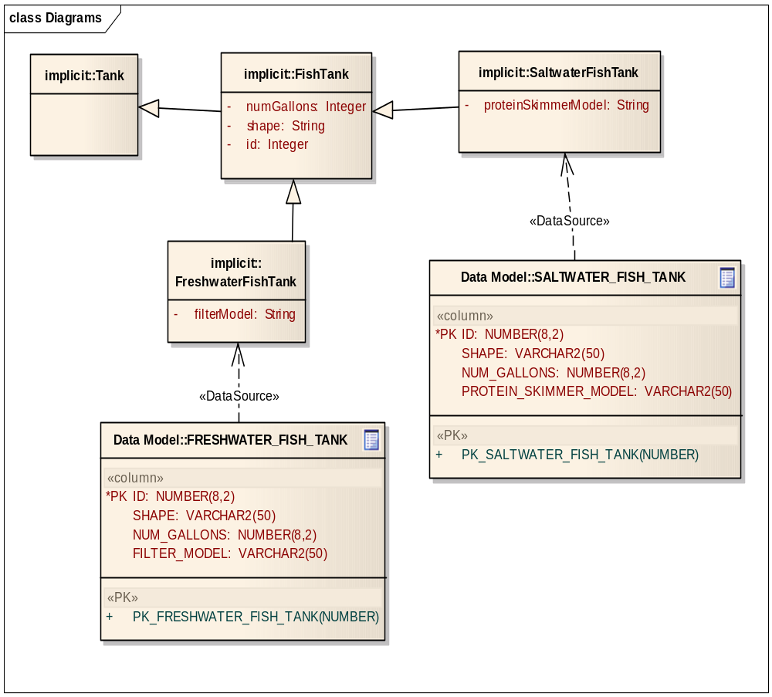
UML Modeling – Implicit Inheritance
In the Implicit inheritance option, there is no table for the implicit classes. The hierarchy starts with the abstract classes and when it encounters the concrete class, a corresponding table must exist. You must map all of the attributes of the abstract class inside the table for the child class. This is required because the parent classes do not have a corresponding table.

Slide 14
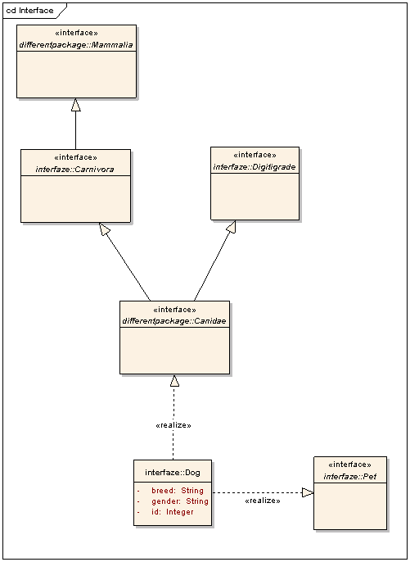
UML Modeling – Interfaces
A marker interface is an interface that does not declare any methods. Its mere presence implies certain functionality. It is typically used to simply mark, or indicate that the class implements the behavior implied by the marker interface.
A non-marker interface is an interface that declares methods. SDK supports implementing non-marker interfaces and implementing Class elements through tag values.

Slide 15
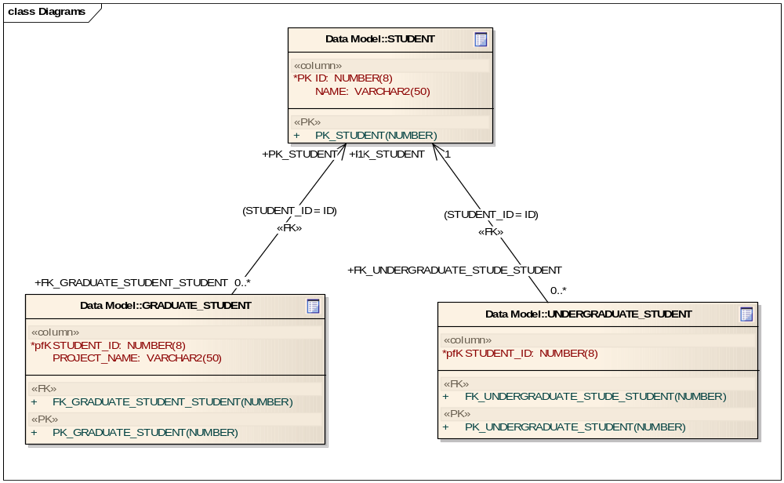
UML Modeling - Inheritance

Slide 16
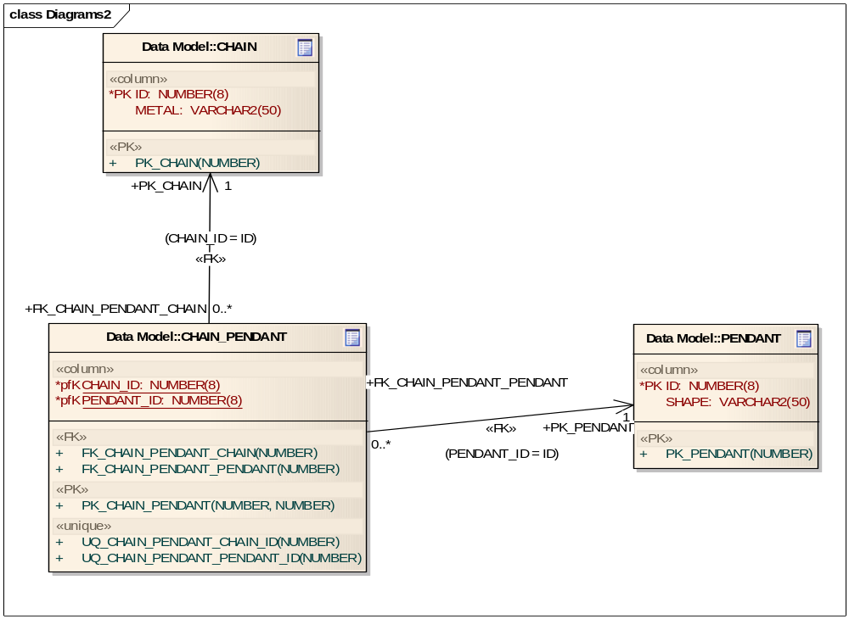
UML Modeling – One to One with Join table

Slide 17
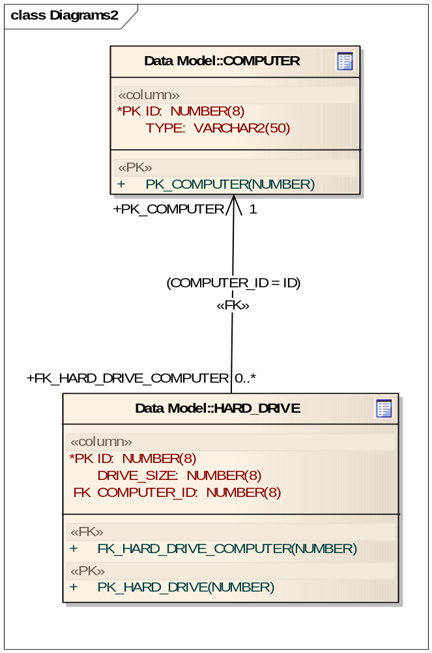
UML Modeling – One to Many

Slide 18
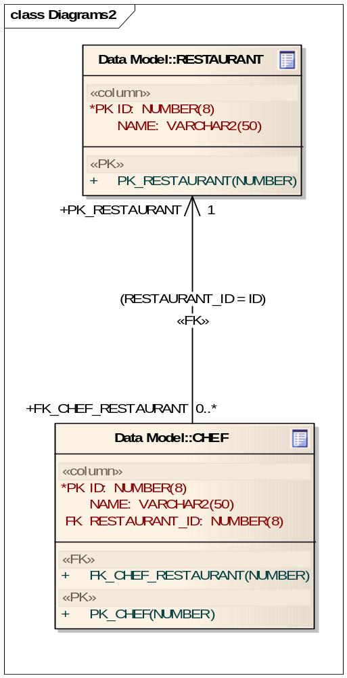
UML Modeling – Many to One

Slide 19
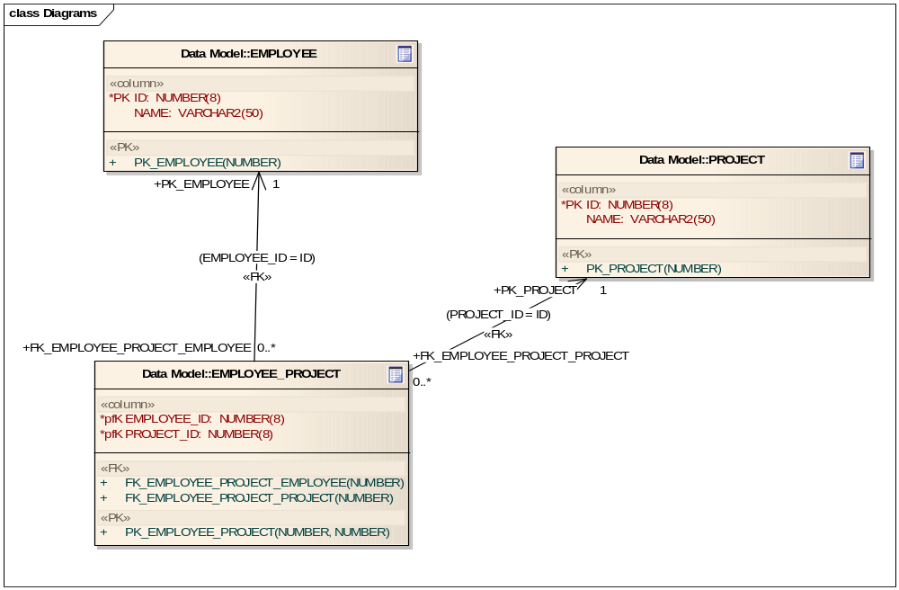
UML Modeling – Many to Many

Slide 20
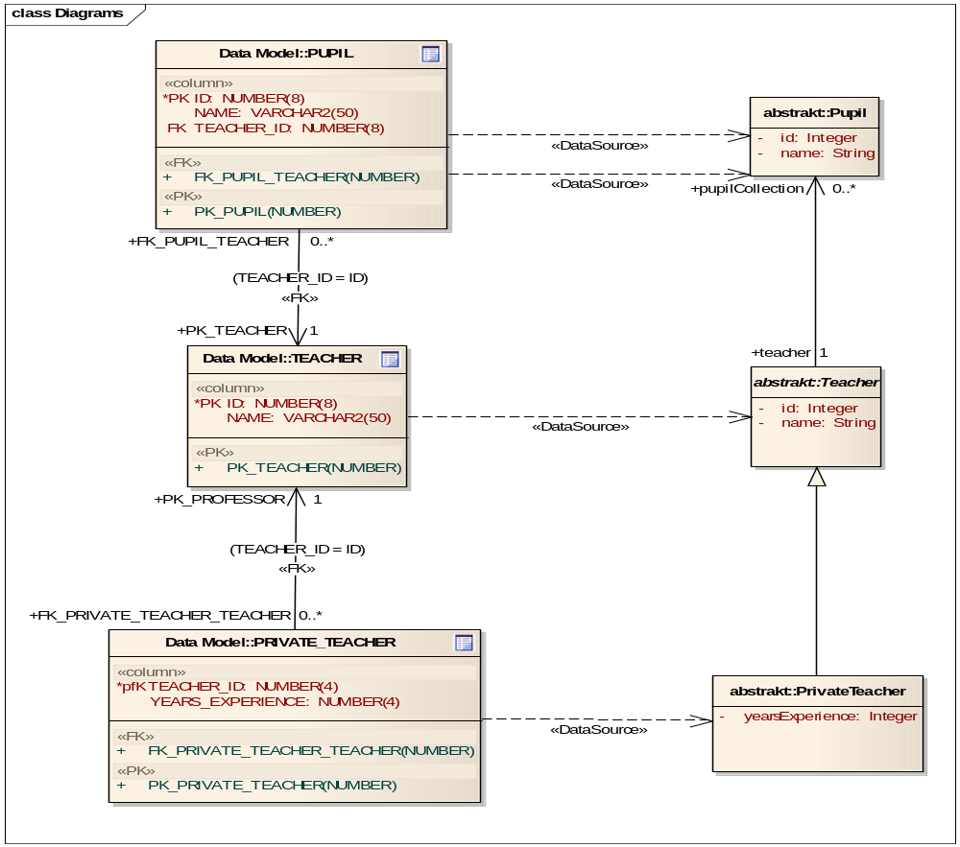
UML Modeling – Model Mapping

Slide 21
Modeling support – Future considerations
Support more UML Model Elements
  Association class (AstraZenca)
    Enables an Association connector to have attributes and operations
  Composite Primary Keys (KC)
  Compositions, Aggregations
  Enumeration
  UML 2.0
Model conversion
  Standardized intermediate format
  Convert from and to other standardized formats
Data model or Logical model can be optional
  Generate data model based on logical model and vise versa.

Slide 22
SDK Generated Artifacts
Beans
  A Java bean is created for each object in the object model
  Compiled and packaged in a JAR file
Hibernate Files
  Packaged in a separate JAR file
  Hibernate Mapping File
  Hibernate Configuration File
  EHCache Configuration File
XSD and XML Mapping Files
  XSD File is created for each package in the object model
  Castor mapping files (XML) are generated for entire model
  JAB Annotations and configuration files
Web Service Deployment Descriptor File
  Deployment configuration file for the AXIS-based web service is generated for the entire model
Notes:
The SDK generates various artifacts based on the information that it obtains from the UML model. Here is a comprehensive list of the artifacts generated by the SDK:
Beans
A Java bean is created for each object in the object model
Compiled and packaged in a JAR file
Hibernate Files
Packaged in a separate JAR file
Hibernate Mapping File
Hibernate Configuration File
EHCache Configuration File
XSD and XML Mapping Files
XSD File is created for each package in the object model
Castor mapping files (XML) are generated for entire model
Web Service Deployment Descriptor File
Deployment configuration file for the AXIS-based web service is generated for the entire model

Slide 23
Features of the Runtime System
Provides various mechanisms to access data
  Local Java client
  Remote Java client
  Web services
  Web based UI
  REST-like interface
Query By Example (QBE) Interface
  Queries can be formed using information model
  Syntactically interoperable system
Allowing client to access data from multiple remote services
Seamless navigation of data source
  Built in pagination of the result set
  Ability to fetch associations on demand in transparent manner
Integration with caGrid tools
  Plug-in available in caGrid’s Introduce toolkit to create a grid service from a SDK generated system
Notes:
This slide shows a few features of the runtime system generated by the SDK. The SDK provides five different ways to get access to the data in a database. The primary Interface that has been used by most people is the Local and Remote Java client. Local java client generates an API which works directly with the database. The remote java client is a remote client server base architecture where you can query the data sitting in a remote database. If you are at NCI and want to query the data at Ohio State University - you can fire a query if you have a SDK generated client for that part of the application.SDK also provides web services - if you have an alternate based client that can’t use the java based application; it can certainly work with web service. SDK also has a web based UI and a RESTful interface. Web Based UI is a query by example type of system. The RESTful interface is where you can access the data in HTML or XML format by using the static URL. If you have a thin client (which does not have a java script) which needs access to your underlying database, you can use the RESTful interface to fire a query that returns data XML format. You can then use an API to display it on the client’s side.
The query by example (QBE) interface: SDK allows you to form a query based on the information model which makes the system syntactically interoperable. It is still not semantically interoperable, until you register your metadata in the caGrid infrastructure (there are tools which allows you to do queries - the federated query processor).
Another powerful feature of SDK is it allows the client to access the data from multiple locations. If you have a clinical trials database installed at four different cancers centers and are writing an application to do a population-wide study by joining results or the outcome of the data that is stored at the 4 cancer centers, you can use the SDK’s remote client and connect to all of them at the same time. You are able to download the data and then manually/programmatically analyze the results set and display them back to the client.

Slide 24
N-Tier Architecture
Each tier in the system is responsible for a set of defined activities:
Persistence Tier: responsible for understanding the query that has been sent and for fetching the results
  SDK currently supports persistence tiers created in two ways; object-relational mapping (ORM) based persistence tiers and non-object-relational mapping (Non ORM) based persistence tiers
Application Service Tier: consolidates incoming requests from various interfaces and forwards them to the appropriate persistence tier implementation
Security Interception Tier: ensures that only authorized users can access the system
  The security configuration in the SDK is done using the ACEGI and the Common Security Module (CSM) developed by NCICB
  For an unsecured system, this layer is disabled through the configuration files
Client Interface Tier: methods of retrieving data
  1. XML-HTTP Interface (browsers, thin clients)
  2. Web Services Client
  3. Local Java API Client
  4. Remote Java API Client
Notes:
A main component of the SDK generated system is that it is built on a n-tier architecture.
Each tier in the system is responsible for a set of defined activities:
Persistence Tier: responsible for understanding the query that has been sent and for fetching the results
SDK currently supports persistence tiers created in two ways; object-relational mapping (ORM) based persistence tiers and non-object-relational mapping (Non ORM) based persistence tiers
Application Service Tier: consolidates incoming requests from various interfaces and forwards them to the appropriate persistence tier implementation
Security Interception Tier: ensures that only authorized users can access the system
The security configuration in the SDK is done using the ACEGI and the Common Security Module (CSM) developed by NCICB
For an unsecured system, this layer is disabled through the configuration files
Client Interface Tier: methods of retrieving data
1. XML-HTTP Interface (browsers, thin clients)
2. Web Services Client
3. Local Java API Client
4. Remote Java API Client

Slide 25
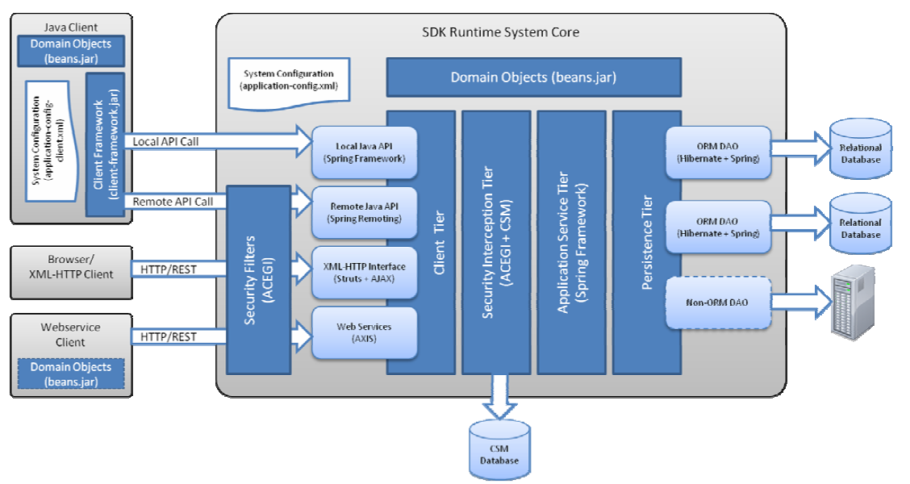
Runtime System
High Level Architecture
Notes:
The caCORE SDK generated runtime system’s infrastructure exhibits an n-tiered architecture with client interfaces, server components, backend objects, data sources, and additional backend systems. This n-tiered system divides tasks or requests among different servers and data stores. This isolates the client from the details of where and how data is retrieved from different data stores. The system also performs common tasks such as logging and provides different levels of security. Clients (browsers, applications) receive information from backend objects. Java applications also communicate with backend objects via domain objects packaged within the client.jar. Non-Java applications can communicate via SOAP (Simple Object Access Protocol). Back-end objects communicate directly with data sources, either relational databases (using Hibernate) or non-relational systems (using, for example, the Java RMI API).

Slide 26
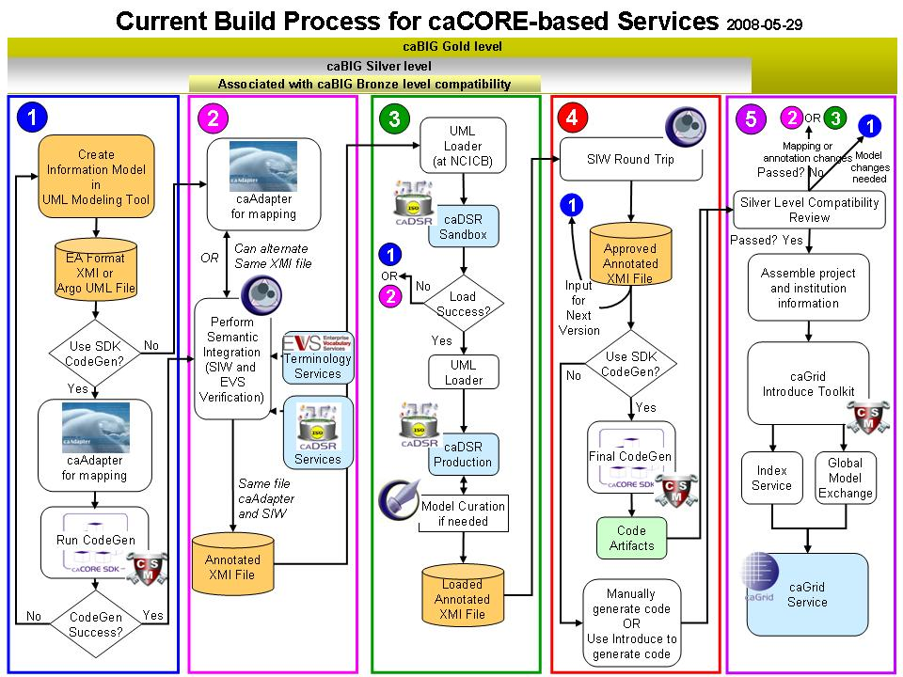
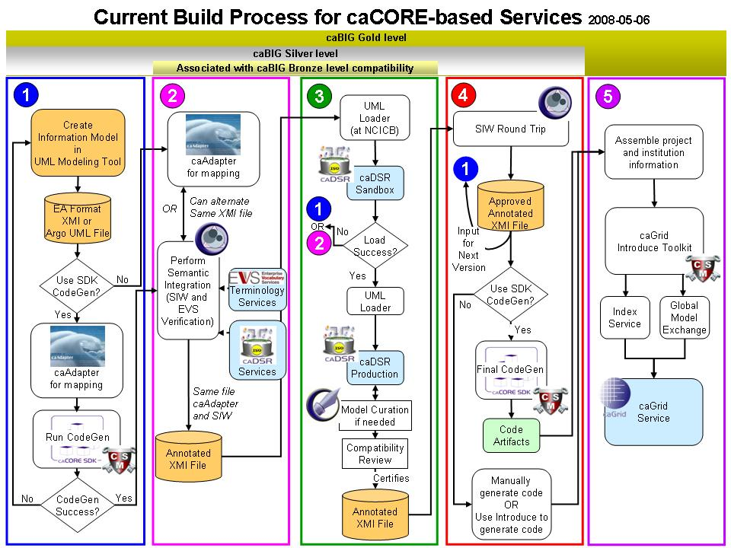
Metadata Reuse
Create UML Model
Semantic Annotation
Transform UML Model into Metadata
SDK Code Generation
Compatibility Review
Create a Node on the Grid

Slide 27











Runtime System
Generated System
Core Services
Registered in
Registered in
Semantically described with terminology from
Object
Definition
WSDL
XSD
Map to
Service Definition
Validate against
SDK Service
Generated by Introduce
SDK Service API
SDK Client API
Grid Service
Grid Client API
Client App
Oracle
Database
Objects
Java API
Reads
XML
Objects
MySQL
Database
Objects
Java API
Reads
Objects
Client uses
Service Definition
WSDL
XSD
Validate against
Web Service
Client uses
CSM
Security
Database
XML
Checks
Internet Browser
HTTP/REST
XML/ HTML
Notes:
This slide represents the architecture of a caCORE SDK generated system. We have a user (right side of the diagram) who wants to get access to the data sitting all the way on the left in two different databases; it could be Oracle or My SQL, that’s what SDK currently supports. The first step is to map the database tables into an object definition. Once the object definition has been constructed into an object model using a modeling tool such as ArgoUML or Enterprise Architect, we semantically annotate the object model with EVS concepts. The model is then registered into caDSR. The steps along the top of the diagram relate to the CORE services, those steps are not required in order to use SDK, but if you don’t complete those steps you won’t achieve semantic interoperability. The user will write a client application, use internet explorer or a browser to access the data (as shown on the right side of the diagram). On the left side, the SDK creates a service API to translate the query into a hibernate-specific call and then internally fire it against the database to get the result set. So we generate that particular system and then we provide a client to access that particular remote server. The communication between the client and server, everything is going to be based on the object definitions. And the client application will access the SDK generated client API using the same objects, so we are not converting the data into XML or any other format at this particular point, we are just converting your object graphing and propagating it onto the client side.
SDK also provides a web service that the SDK Service API is going to export a service definition to a WSDL document which has reference to the XSD for the different domain objects that it has been supporting. The client application can invoke that web service and get the data back in XML format, which is then validated against a WSDL document.
Across the bottom of the slide the internet browser can access the data using an XML or HTML format. Since SDK has the security built in using the CSM database all you have to do is flip a flag during system generation to perform a check against the CSM security policy.
Everything covered in this diagram so far, except for the client application and internet browser, has been generated by the SDK. The block in the middle of the diagram is generated by a tool called Introduce. Introduce allows you to build a grid service on top of a SDK generated system. To do so, take the SDK generated client and run it through the Introduce tool kit and provide appropriate input. The output is a grid service. The client application accesses the data in the grid environment through the grid client API.

Slide 28
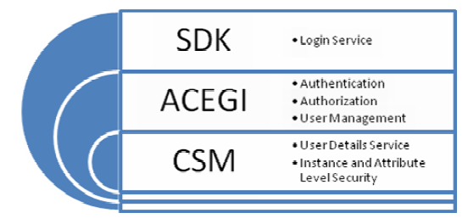
SDK Security
caCORE SDK provides an integrated security solution that uses Acegi and Common Security Module (CSM)
Acegi intercepts calls from users
CSM provides security at the core level
By default, security is disabled in the SDK configuration
  Enable security flag in configuration file and generate the system
Notes:
caCORE SDK provides an integrated security solution that uses Acegi and Common Security Module (CSM)
SDK provides the login service
Acegi intercepts calls from users and provides authentication, authorization and user management.
CSM provides the User Details Service as well as Instance and Attribute Level Security
By default, security is disabled in the SDK configuration, the security flag must be enabled in the configuration file and then generate the system.

Slide 29
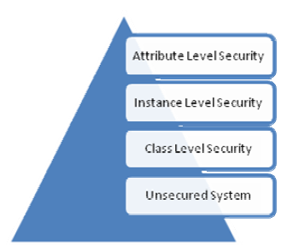
SDK - Security Levels
Unsecured / No Security
  All SDK users have equal access to the data
Class Level Security
  Only users who have access to certain objects can query the data
Instance Level Security
  Users are only allowed to access data to which they have access
    Doctors can view their patient’s information only
Attribute Level Security
  Users are allowed to see data for which they have authorization
    Doctors can view patient’s medical record number, but not social security number
Notes:
There are 4 levels of Security available for a caCORE SDK generated system. These include: usecured/no security, class level security, instance level security, and attribute level security.
Unsecured / No Security
All SDK users have equal access to the data
Class Level Security
Only users who have access to certain objects can query the data
Instance Level Security
Users are only allowed to access data to which they have access
Doctors can view their patient’s information only
Attribute Level Security
Users are allowed to see data for which they have authorization
Doctors can view patient’s medical record number, but not social security number

Slide 30
Writable API
The Writable API is an extension to the Read API to support CRUD operations.
Object Relational Considerations through UML Tag Values
  Primary Key generator
The global primary key generator can be specified in the codegen.properties
Class level key generator using UML tag values in the model
  Cascade settings
Specify update settings on the associations using UML tag values
  Inverse settings
Inverse settings to remove cyclical dependency of the object graph being persisted
Transactions
By default, the configured transaction manager is Hibernate transaction manager implementation

Slide 31
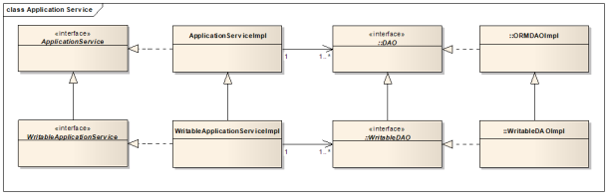
Writable API

Slide 32
Logging and Auditing
caCORE SDK code generator injects a Common Logging Module (CLM) based interceptor in the persistence tier of the system
The CLM interceptor, with help of a Log4j appender, creates a log statement when it detects a change in the state of an object
In order to detect a change in the state of an object, whenever an attempt is made to persist the changed domain object in the database, the CLM object state logger intercepts all the events related to the domain object change. As CLM detects the change in the object's attributes, it creates a new log message
CLM provides a companion application called Log Locater Tool (LLT) for viewing the log statements previously inserted by the database appender.

Slide 33
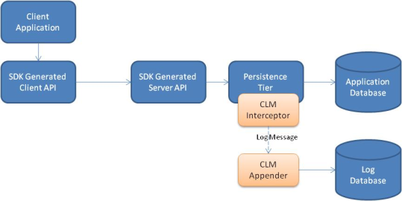
Logging and Auditing

Slide 34
Query Support
1. HQL Query
Hibernate is equipped with a powerful query language, called Hibernate Query Language (HQL) that is similar to SQL. However, though the syntax is SQL-like, HQL is still fully object-oriented and understands concepts like inheritance, polymorphism, and association.
2. Detached Criteria Query
HQL is extremely powerful, some developers prefer to build queries dynamically using an object-oriented API, rather than building query strings. To this end, Hibernate provides an intuitive Criteria query API.
3. CQL Query
SDK provides language neutral caCORE SDK-specific queries. CQL is one of such two query mechanisms. caCORE SDK CQL queries are modeled similarly to the object representation of the caBIG Query Language (CQL), which uses syntax similar to the Query-by-Example (QBE) query language to specify the way results are to be retrieved.
4. Nested Search Criteria Query
SDK Nested Search Criteria queries are developed specifically for caCORE SDK and have two parts: 1) a comma separated path to the target search object and 2) an example of the source object.

Slide 35
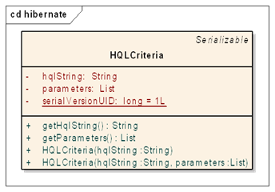
Query Support – HQL Query
SDK contains a wrapper class called HQLCriteria, which is used for submitting HQL queries.
ApplicationService Method
query(HQLCriteria hqlCriteria)

Slide 36
Query Support – HQL Query
Example:
ApplicationService appService = ApplicationServiceProvider.getApplicationService(); HQLCriteria hqlCrit = new HQLCriteria("from gov.nih.nci.cacoresdk.domain.other.levelassociation.Suit"); Collection results = appService.query(hqlCrit);
for(Object obj : results) {
printObject(obj, Suit.class);
}

Slide 37
Query Support – Detached Criteria Query
The Hibernate Detached Criteria extends the Criteria concept, allowing Criteria queries to be created outside of the scope of a session, to be executed later using some arbitrary Hibernate Session.
ApplicationService Method
query(DetachedCriteria detachedCriteria)
ApplicationService appService = ApplicationServiceProvider.getApplicationService();
DetachedCriteria detachedCrit = new DetachedCriteria.forClass(Suit.class) .add( Property.forName("id").eq(1) );
Collection results = appService.query(hqlCrit);
for(Object obj : results) { printObject(obj, Suit.class); }

Slide 38
Query Support – Nested Criteria Query
The comma separated path starts with the target object to be retrieved from the database (using the fully qualified name of the class). The next item in the comma-separated path is a link in the chain to an element that connects the element on its left to the element on its right (also using the fully qualified name of the class). The element on the right could be the example object or another element in the chain. The linked element provides a mechanism to traverse from the example object to the desired object using a comma separated path.
ApplicationService Methods
search(String path, List<?> objList)
search(Class targetClass, List<?> objList)
search(Class targetClass, Object obj)
search(String path, Object obj)

Slide 39
Query Support – Nested Criteria Query
ApplicationService appService = ApplicationServiceProvider.getApplicationService();
Card card1 = new Card();
card1.setId(6);
Card card2 = new Card();
List<Card> cardCollection = new ArrayList<Card>(); cardCollection.add(card1);
cardCollection.add(card2); String path = "gov.nih.nci.cacoresdk.domain.other.levelassociation.Suit," + "gov.nih.nci.cacoresdk.domain.other.levelassociation.Card";
Collection results = appService.search(path, cardCollection); System.out.println("Number of qualifying records: " + results.size()); for(Object obj : results) {
printObject(obj, Suit.class);
}

Slide 40
Query Support – CQL Query(caGrid Implementation)
The caGrid Query Language, or CQL is the query language used for all caGrid Data Services to express object-oriented queries against a data service. It is defined in an XML document conforming to a well defined schema with the URI http://CQL.caBIG/1/gov.nih.nci.cagrid.CQLQuery
ApplicationService Method
search(gov.nih.nci.cagrid.CQLQuery query)

Slide 41
Query Support – CQL Query (caGrid Implementation)
Caveats:
CQL does not permit querying for attributes with values that are XML schema complex types. Only values that can be represented as XML schema simple types are allowed.
CQL Attribute Results cannot contain attribute values which are XML schema complex types. Only values that can be represented as XML schema simple types are allowed.
CQL does not provide a facility for returning object instances other than the targeted data type. This includes subclasses of the targeted data type. These cannot be returned because their XML representation will differ from that of the requested object, which violates the expected results schema.
CQL cannot return populated associations on instances of the targeted data type. This has some implications when dealing with uni-directional associations.

Slide 42
Query Support – CQL Query(SDK Implementation)
Address the caveats in caGrid CQL (A parallel implementation)
Language neutral caCORE SDK-specific queries. CQL is modeled similarly to the object representation of the caBIG Query Language (CQL), which uses syntax similar to the Query-by-Example (QBE) query language to specify the way results are to be retrieved.
The Data Services CQL wiki page (caGrid.org) describes an XML representation of the CQL. The caCORE SDK Code Generator, however, consumes a corresponding object representation of the query instead of the XML version
ApplicationService Method
query(CQLQuery cqlQuery)

Slide 43
CQL Query (SDK)
Data Service Implementation
caGrid
SDK
caGrid Service
CQL 2 HQL
SDK generated Data Service
Client
HQL
CQL 2 HQL

Slide 44
CQL Query (SDK)
Data Service Implementation
Version Conflicts
caGrid
SDK
caGrid Service
CQL 2 HQL
V1.4
HQL
SDK generated Data Service
Client
HQL
CQL 2 HQL
V1.3

Slide 45
Future Consideration
CQL Query (caGrid) - Clean Seperation
caGrid
SDK
caGrid Service
CQL 2 HQL
V x.x
HQL
SDK generated Data Service
Client
HQL
CQL 2 HQL
V1.3

Slide 46
Future Consideration
SDK CQL Query
CQLQuery in SDK is a duplication of caGrid CQL with fixes to the caveats
caGrid data services supports only caGrid CQL query
No known implementation is using SDK CQL implementation
CQL2 addresses many of the caveats
As caGrid CQL is refined, SDK CQL needs to realign with it
Future consideration is to remove SDK CQL to remove redundancy

Slide 47
Client Interfaces
1. XML-JSON-HTTP interface
This can be accessed in two ways: from a web browser or from a thin client application that can fetch data in XML or JavaScript Object Notation (JSON) format from the server using the REST-like syntax
2. JAVA API Interface
Local Interface
Remote Interface
3. Webservice Interface
SDK 4.x Web Service interface is based on the Axis 1.4 framework, which adheres to the J2EE 1.4 server programming model described by JAX-RPC and JSR 109

Slide 48
REST Interface
The REST architectural style was developed in parallel with HTTP/1.1, based on the existing design of HTTP/1.0.^{[1]} The largest implementation of a system conforming to the REST architectural style is the World Wide Web.
REST is a style of designing loosely coupled Web applications that rely on named resources — in the form of Uniform Resource Locators (URLs), Uniform Resource Identifiers (URIs), and Uniform Resource Names (URNs), for instance — rather than messages.
REST is an architecture, unlike SOAP, which is a protocol. REST supports CRUD via the HTTP POST, GET, PUT, and DELETE requests, respectively.
A concrete implementation of a REST Web service follows four basic design principles:
  Use HTTP methods explicitly.
  Be stateless.
  Expose directory structure-like URIs.
  Transfer XML, JavaScript Object Notation (JSON), or both.
¹ http://en.wikipedia.org/wiki/REST

Slide 49
REST Interface
SDK supports REST-like query through its web application.
The URL used by the REST interface adheres to the following pattern:
  http://<server_name><server_port>/<project_name>/ <REST_type>?query=<target>&<criteria>[&rolename=<rolename>]
Supports querying ISO 21090 data types
Convert REST-like XML to HTML, JSON
Parameter | Description
Project_name | A string identifying the project name used for building and deploying the SDK application.
REST_type | GetXML for XML output GetJSON for JavaScript Object Notation output

Slide 50
REST Interface (cont..)
Parameter | Description
Target | A string identifying the qualified or non-qualified query target/result class name. Example: gov.nih.nci.cacoresdk.domain.inheritance.childwithassociation.Bank
Criteria | A string identifying the qualified or non-qualified criteria class name to be used as a filter/constraint on the result set. Example: Credit[@id=3]
Rolename | The name of the attribute within the criteria class that identifies the association to be traversed when retrieving the target/result class(es). The rolename property must be specified whenever the Criteria class has two or more attributes representing associations to the same target/result class type.
Notes:
Criteria Example: The SDK sample model Credit class has an association to the Bank class via its issuingBank attribute. If desired, the value of the id attribute of the criteria class instance can also be supplied in order to further constrain the result set. The pattern for such a criteria string is:
<criteria_class_name>[@<attribute_name>=<attribute_value>]
So that the criteria entry of Credit[@id=3] indicates that only target/result class instances that are associated to the Credit record with an id value of 3 are to be returned.
Rolename Example: The Child class within the sample SDK model contains two attributes: mother and father. Both represent instances of the Parent class. In this scenario, specifying a value of rolename=mother or rolename=father within the REST URL would ensure that the correct Parent instance is returned.

Slide 51
REST Interface (cont..)
The following table provides some example URLs taken from the sample SDK model.
Sample XML REST URL | http://localhost:8080/example/GetXML?query=Bank&Credit[@id=3]&roleName=issuingBank
Sample JSON REST URL | http://localhost:8080/example/GetJSON?query=Bank&Credit[@id=3]&roleName=issuingBank

Slide 52
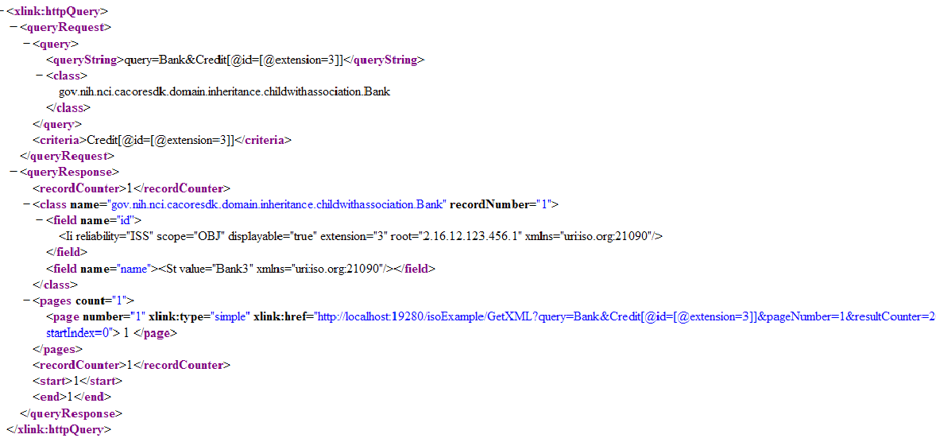
REST Interface (cont..)
Sample XML output from REST call

Slide 53
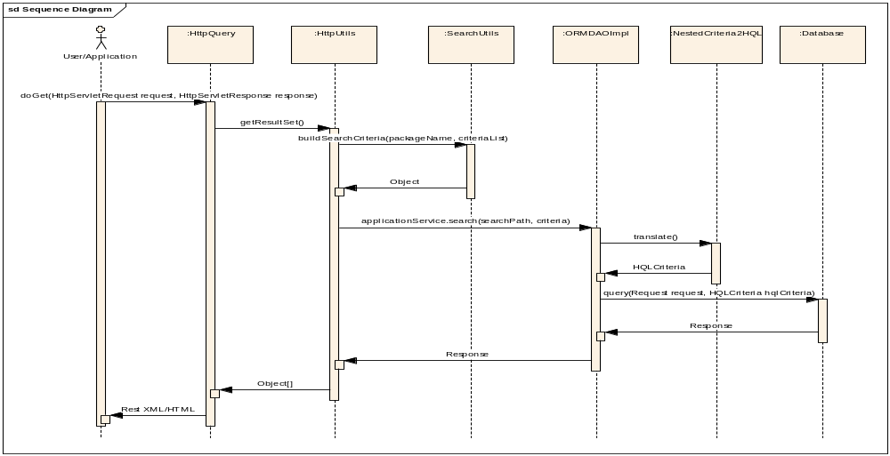
REST Interface (cont..)
Client
Servlet Interface
Transform
Application Service
DAO

Slide 54
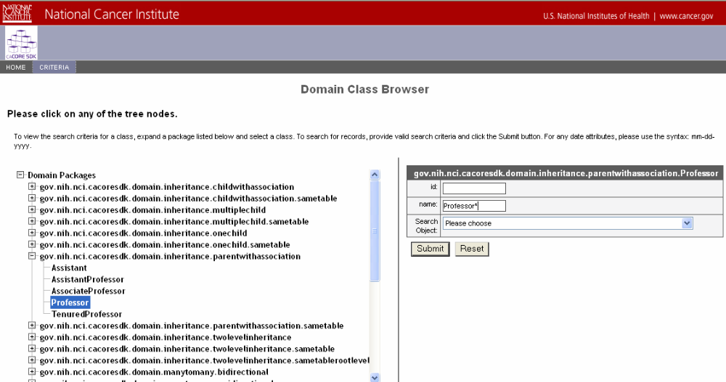
XML-HTTP Interface – Search Page
Notes:
A Search Criteria form listing the searchable class fields is displayed to the right of the browser tree. To search for date attributes, use the syntax: mm-dd-yyyy. The Search Criteria form accepts the asterisk (‘*’) as a wildcard character. The Search Criteria form also contains a drop-down list containing Search Objects (domain classes) that are associated with the current domain class. Selecting a Search Object from the drop-down list causes the query to return records of the type represented by the Search Object, and not records of the type represented by the selected class, which is the default if no Search Object is selected.
Click the Submit button on the Search Criteria form to display any matching records on the Result Data Table page in a new window.

Slide 55
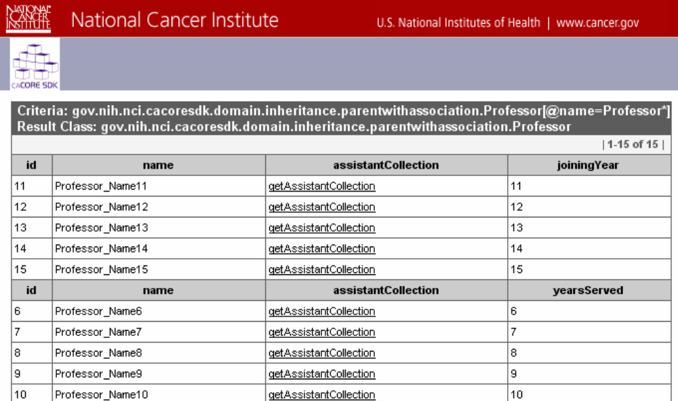
XML-HTTP Interface – Results Page
Notes:
Fields from the resulting domain class type (Professor) are displayed as table columns within the table header on the Results page. A collection of wrappers of primitive object types and field values are displayed as strings within the corresponding table cells. Fields that represent an association to another domain class are displayed as links, which can be clicked to retrieve any associated domain object records.

Slide 56
Runtime System caGrid Data Service Vs
SDK REST-like Service
Core Services
Registered in
Registered in
Semantically described with terminology from
Object
Definition
WSDL
XSD
Map to
Service Definition
Validate against
SDK Service
Generated by Introduce
SDK Service API
SDK Client API
Grid Service
Grid Client API
Client App
Oracle
Database
Objects
Java API
Reads
XML
Objects
MySQL
Database
Objects
Java API
Reads
Objects
Client uses
Service Definition
WSDL
XSD
Validate against
Web Service
Client uses
CSM
Security
Database
XML
Checks
Internet Browser
HTTP/REST
XML/ HTML

Slide 57
REST Interface –
Thin client example
Example:
pulbic Person getPerson(String SSN) throws Exception
{
URL url = new URL(http://localhost:8080/example/GetXML?query=Person[@ssn=00-000-00]);
BufferedReader in = new BufferedReader( new InputStreamReader( url.openStream()));
String inputLine;
StringBuffer buffer = new StringBuffer();
while ((inputLine = in.readLine()) != null)
buffer.append(inputLine);
Person person = (Person) XMLUtility.fromXML(buffer.toString());
return person;
}

Slide 58
REST Interface – Comparison
Java Interface
Example:
pulbic Person getPerson(String SSN) throws Exception
{
ApplicationService service = ApplicationServiceProvider.getApplicationService();
Person person = new Person();
person.setSSN(SSN);
Collection results = service.search(Person.class, person);
if(results != null)
return results.iterator().next();
return null;
}

Slide 59
REST Interface – Comparison
Webservice Interface
Example:
pulbic Person getPerson(String SSN) throws Exception
{
String url = http://localhost:19280/example/services/exampleService;
Service service = new Service();
Call call = (Call) service.createCall();
Class targetClass = Person.class;
Person criteria = new Person();
criteria.setISSN(SSN);
QName searchClassQName = new QName("urn:"+getInversePackageName(criteria.getClass()), criteria.getClass().getSimpleName());
call.setTargetEndpointAddress(new java.net.URL(url));
call.setOperationName(new QName("exampleService", "queryObject"));
call.addParameter("arg1", org.apache.axis.encoding.XMLType.XSD_STRING, ParameterMode.IN);
call.addParameter("arg2", searchClassQName, ParameterMode.IN);
call.setReturnType(org.apache.axis.encoding.XMLType.SOAP_ARRAY);

Slide 60
REST Interface – Comparison
Webservice Interface (cont..)
call.registerTypeMapping(Character.class, searchClassQNameToMap,
new org.apache.axis.encoding.ser.BeanSerializerFactory(Character.class, searchClassQNameToMap), new org.apache.axis.encoding.ser.BeanDeserializerFactory(Character.class, searchClassQNameToMap));
Object[] results = (Object[])call.invoke(new Object[] { targetClass, criteria });
if(results != null)
return results[0];
return null;
}

Slide 61
REST Interface – Comparison
caGrid Service
Example:
Public person getPerson(String SSN)
{
String s_GridSvcUrl = "http://localhost:9080/wsrf/services/cagrid/PersonService";
DataServiceClient client = new DataServiceClient(s_GridSvcUrl);
CQLQuery query = new CQLQuery();
Object target = new Object();
target.setName(“gov.nih.nci.cacoresdk.domain.Person”);
Attribute attribute = new Attribute();
attribute.setName(“ssn");
attribute.setValue(SSN);
attribute.setPredicate(Predicate.EQUAL_TO);
target.setAttribute(attribute);
query.setTarget(target);
CQLQueryResults results = client.query(query);
Iterator iter = new CQLQueryResultsIterator(results, true);
if(iter.hasNext())
return iter.next();
return null;
}

Slide 62
REST – Future Considerations
  Standardize query URL formats
  Support CRUD operations
  Support generation, configuration and deployment of JAX-RS based REST Webservice
  Support RESTful Service Discovery via HTTP
  Support Query Requests with Large Inputs
  Support complex queries

Slide 63
Java API Interface
The use of the Java API client involves 2 primary steps:
  Obtain a reference to the instance of ApplicationService interface from the ApplicationServiceProvider class
  Invoke one of the interface methods in order to fetch the results from the SDK generated server component
Convenience, HQL, Detached Criteria, CQL, Nested Search, Query/Search methods that facilitate read-only access to domain data
Notes:
To use the Java API client, you must do 2 things:
Obtain a reference to the instance of ApplicationService interface from the ApplicationServiceProvider class
Invoke one of the interface methods in order to fetch the results from the SDK generated server component

Slide 64
Web Service Interface
Based on the Axis 1.4 framework
4 styles of service in Axis:
  RPC Services: use the SOAP RPC conventions
  Document Services: do not use any encoding, but do XML<->Java data binding
  Wrapped Services: just like Document Services, but the “unwrap” the SOAP body into individual parameters
  Message Services: receive and return arbitrary XML in the SOAP Envelope without any type mapping / data binding
If the caCORE SDK generated system is secured, the web services user is required to supply user credentials in the form of a web service message header. As part of the web service message, a new header called SecurityHeader is required to be added to the web service call.
Notes:
The final way to access a system generated by caCORE SDK is by the web service interface.
The SDK Web Services is based on the Axis 1.4 framework, which adheres to the J2EE 1.4 server programming model and uses the Remote Procedure Call (RPC) Web Service style.
The web service is automatically deployed because the SDK Web Service Deployment Descriptor (WSDD) is now packaged along with the rest of the SDK generated system.

Slide 65
SDK Future Tasks
Tech Stack upgrade
caGrid/SDK interdependency
UPT enhancement
SDK/Eclipse alignment

Slide 66
Tech Stack upgrade
SDK is currently on 2010 deprecated stack.
Upgrading to 2011 current & future stacks.
CSM, CLM are following the same path.

Slide 67
caGrid/SDK interdependency
Integration through Introduce data service extensions
CQL support (Duplication of caGrid Jars)
Grid authentication support (Duplication of caGrid Jars)
Proposal:
  NO caGrid jar will be copied into SDK and supplied them back to caGrid
  CQL support is done through CQL2HQL conversion
  SDK Grid authentication will become an extension to SDK that can be included through configuration. This extension can support multiple versions of caGrid.

Slide 68
SDK Plugin Environment
Loosely coupled plugin environment
Support code generation for multiple Programming Language
Easy to plugin into existing IDE (Eclipse)

Slide 69
UPT enhancement
Loosely coupled plugin environment
Support code generation for multiple Programming Language
Easy to plugin into existing IDE (Eclipse)

Slide 70
Resource Allocation
% by each product
% by usage (user support, product enhancement)

Slide 71
Future caCORE SDK/CSM/CLM
Align with commonly-used framework
CSM – a kind of framework on which that application dev teams can implement their security model

